Slide 1
Rayleigh and Rician fading
Notes:
1

Slide 2
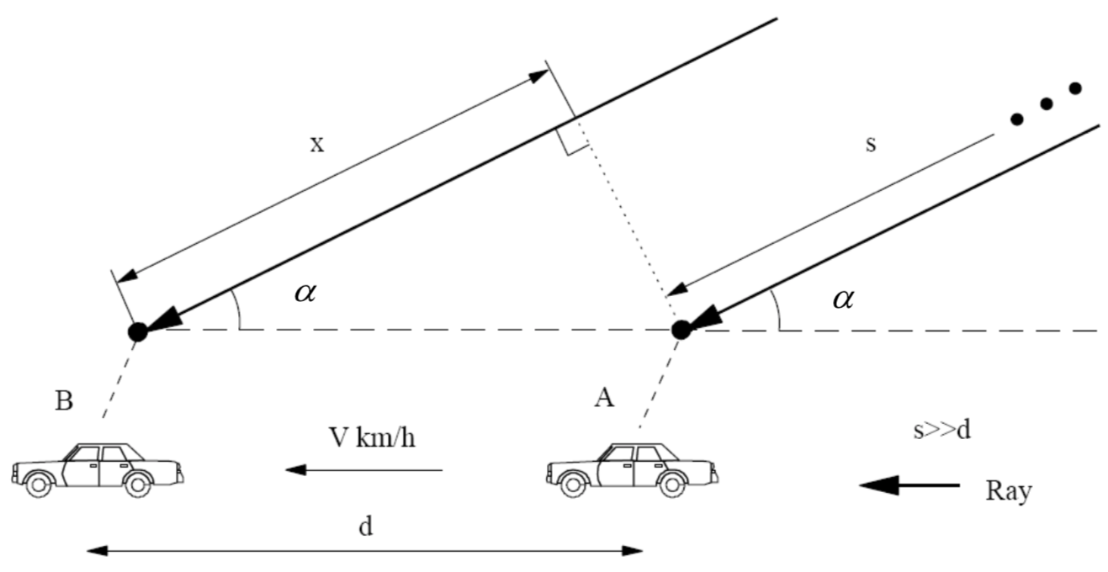
Rayleigh Statistical Field Distribution (1)
To create a Rayleigh distribution, we need the vector sum of a number of paths with similar amplitudes and individual phases (uniformly distributed $0−2π$ radians)
$v$ constant speed $s$ distance from propagating source
$d$ distance moved $α$ angle of arrival in the azimuth plane

Slide 3
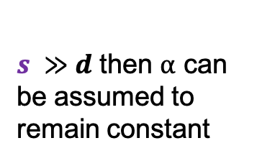
Rayleigh Statistical Field Distribution (2)
Only one of all the arriving paths is shown
$s ≫d$ then $α$ can be assumed to
remain constant
$v$ constant speed $s$ distance from propagating source
$d$ distance moved $α$ angle of arrival in the azimuth plane

Slide 4
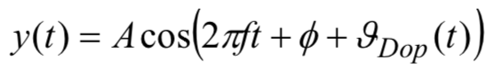
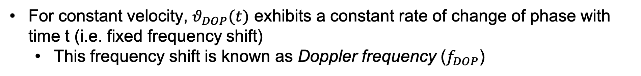
Received waveform (1)
Assuming the transmission of a countinuous wave sinusoidal signal, the received waveformn $y(t)$ at a mobile terminal is given by:
Initial phase of
rx’d waveform
(Point A)
Amplitude of
rx’d waveform
Time-varying phase
as a result of the mobile
moving from A to B
For constant velocity, $θ_{DOP}(t)$ exhibits a constant rate of change of phase with time t (i.e. fixed frequency shift)
This frequency shift is known as Doppler frequency ($f_{DOP}$)

Slide 5
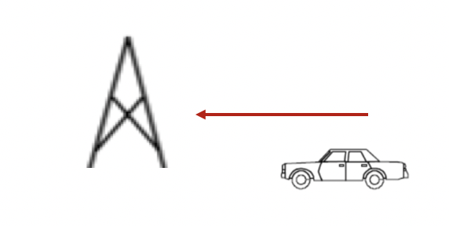
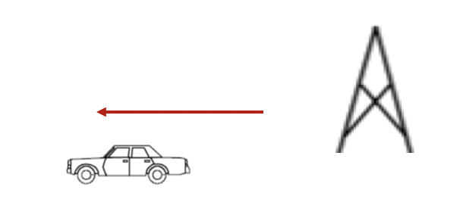
Received waveform (2)
As the mobile moves towards the basestation, the signal experiences a positive Doppler Frequency
Positive Doppler Frequency
As the mobile moves away from the basestation, the signal experiences a negative Doppler Frequency
Negative Doppler Frequency

Slide 6
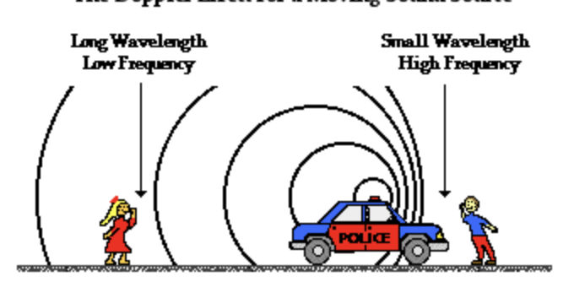
Doppler frequency – Real life example
As police car moves away, the sound becomes low pitched
-ive Doppler Shift
As police car moves towards, the sound becomes high pitched
+ive Doppler Shift

Slide 7



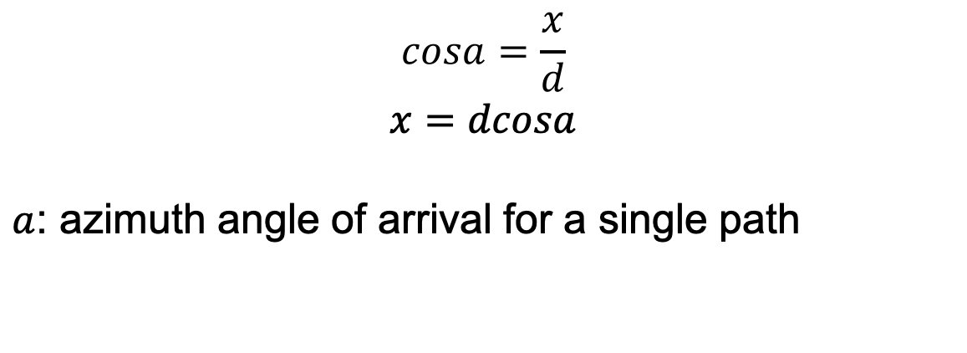

Rate of change of phase (1)
At point B the radio path back to the transmitting
source (vehicle moving away from basestation) is extended to length by distance x
Considering this triangle:
$$x$$
$$a$$
$$cosa=\frac{x}{d}$$
$$x=dcosa$$
$a$: azimuth angle of arrival for a single path
$d$
Notes:
hypotenus

Slide 8
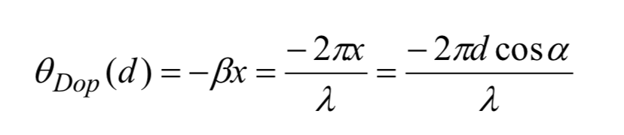
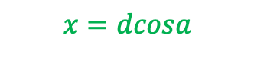
Rate of change of phase (2)
Phase change for a single path:
Terminal is moving
away from BS
$$x=dcosa$$

Slide 9
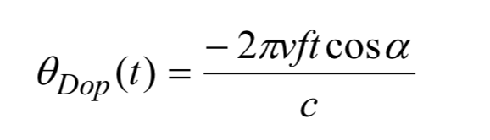
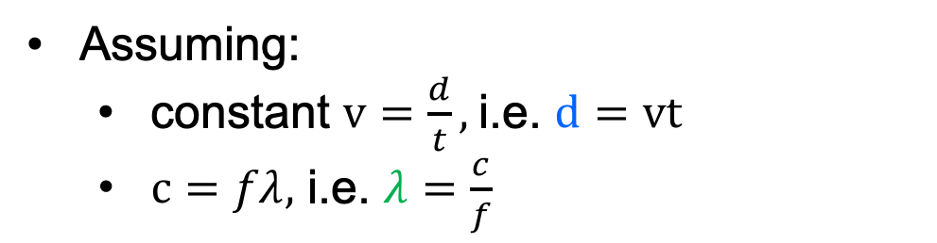
Rate of change of phase (3)
Assuming:
constant $v=\frac{d}{t},$i.e. $d=vt$
$c=fλ,$ i.e. $λ=\frac{c}{f}$

Slide 10
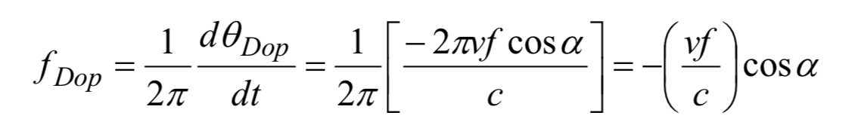
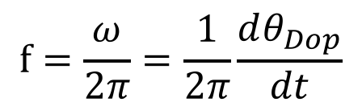
Doppler frequency (1)
The resulting Frequency Shift/Doppler frequency (=rate of phase change due to movement):
$$f=\frac{ω}{2π}=\frac{1}{2π}\frac{dθ_{Dop}}{dt}$$

Slide 11
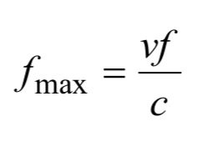
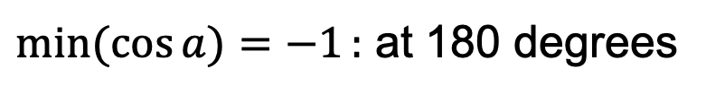
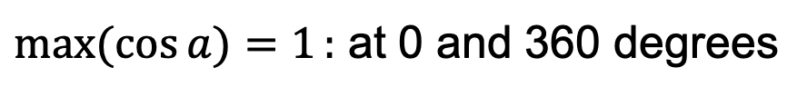
Doppler frequency (2)
For a continuous wave transmission the received signal is shifted by the doppler frequency/shift
The maximum value of the frequency shift (Maximum Doppler shift), depending on the movement (towards or away the BS):
$max(cos{a)=1}:$ at 0 and 360 degrees
$min(cos{a)=−1}:$ at 180 degrees

Slide 12
Doppler frequency (3)
Doppler frequency shift applies to single multipaths
Each path is subject to a specific Doppler shift
When multipaths arrive from different azimuth directions, a range of different Doppler shifts are seen on various multipaths, resulting in frequency spread
Doppler frequency spread: Largest positive shift - largest negative shift
It is applied to a group of multipaths arriving at a specific point

Slide 13
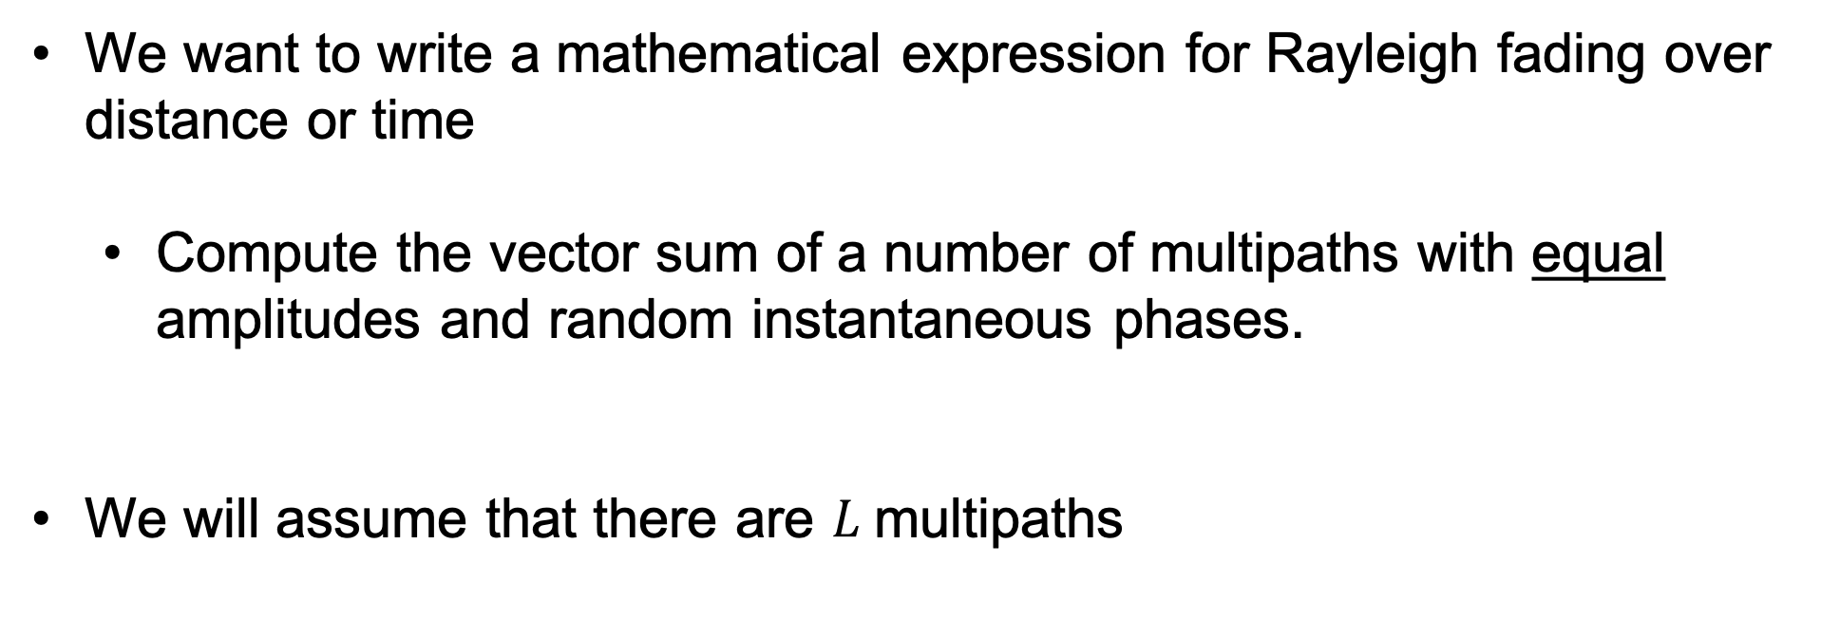
Physical Rayleigh fading model
We want to write a mathematical expression for Rayleigh fading over distance or time
Compute the vector sum of a number of multipaths with equal amplitudes and random instantaneous phases.
We will assume that there are $L$multipaths

Slide 14
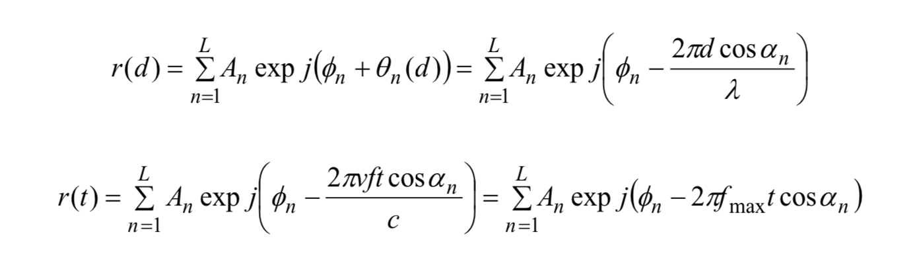
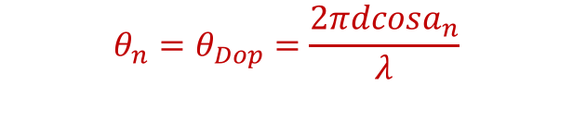
Physical Rayleigh fading model over distance
Assuming $L$ multipaths, the physical Rayleigh fading model over distance:
Amplitude of each path
initial phase at start of motion
number of
multipaths
Additional phase shift due to motion
$$θ_{n}=θ_{Dop}=\frac{2πdcosa_{n}}{λ}$$

Slide 15
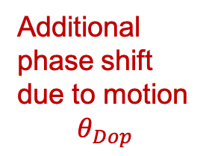
Physical Rayleigh fading model over time
Assuming $L$ multipaths, the physical Rayleigh fading model over time:
Amplitude of each path
initial phase at start of motion
number of
multipaths
Additional phase shift due to motion
$$θ_{Dop}$$

Slide 16
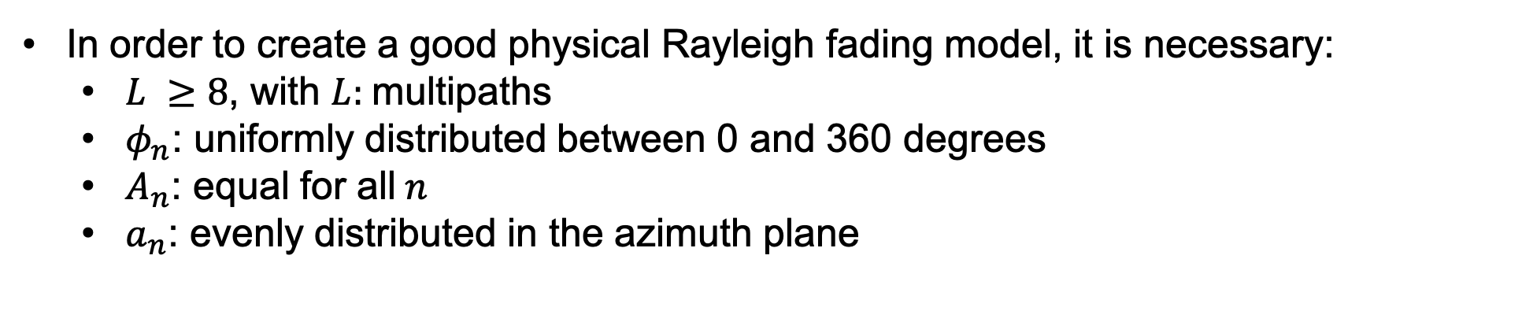
Good Physical Rayleigh fading model
In order to create a good physical Rayleigh fading model, it is necessary:
$L ≥8$, with $L:$multipaths
$φ_{n}$: uniformly distributed between 0 and 360 degrees
$A_{n}$: equal for all$n$
$a_{n}$: evenly distributed in the azimuth plane

Slide 17
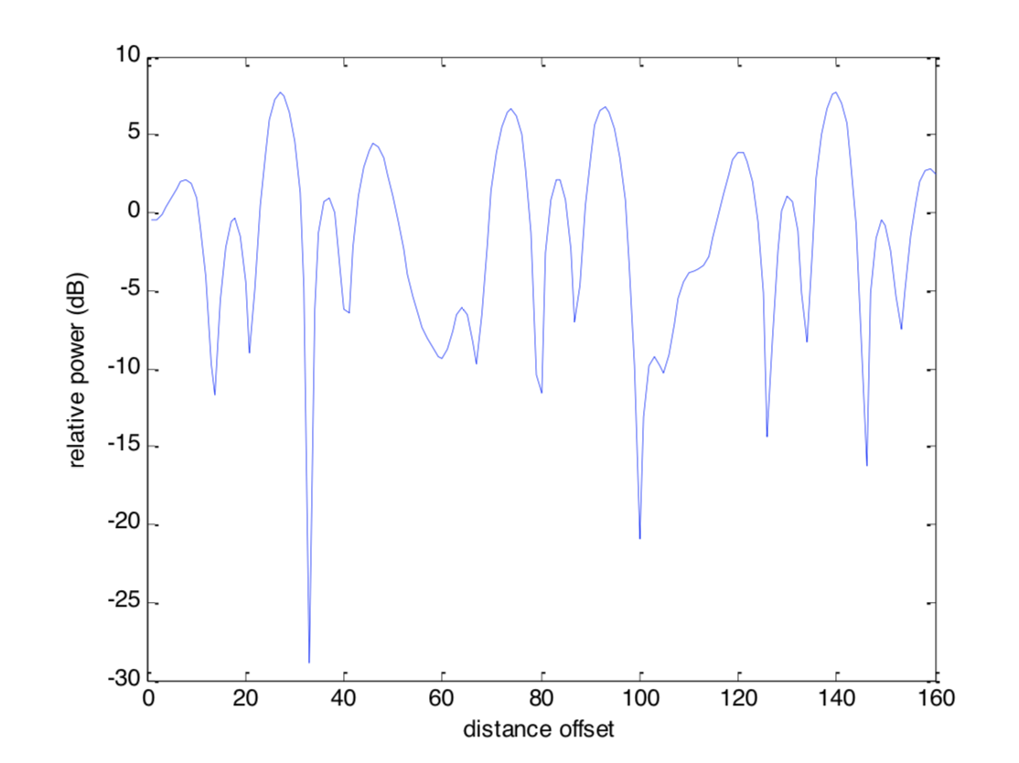
Spatial Rayleigh Fading generated in matlab

